Slide 1

Transformative innovations in
Indian Agriculture
Rajendra Barwale
Chairman, Mahyco Grow
29th January 2021

Slide 2

Indian Agriculture – a context

Slide 3






Prospects of Indian Agriculture
45/60
159.7
2nd
soil types
available
15
million hectares
of arable land
Largest agricultural
land globally
major climates
available
55%
640000 Villages
119
million farmers
working
144
million laborers directly
involved in agriculture
of India’s population
dependent on agriculture
Indian agriculture has the potential to be the major global food provider
Notes:
As all of us, Indian agriculture has enormous potential and opportunities for improvements. We have the second largest arable land globally, 365 days of sunshine in most areas, 15 soil types, a large part of population dependent on agriculture as a primary occupation. With the abundance of nature bestowed on us, India can be the food factory of the world

Slide 4
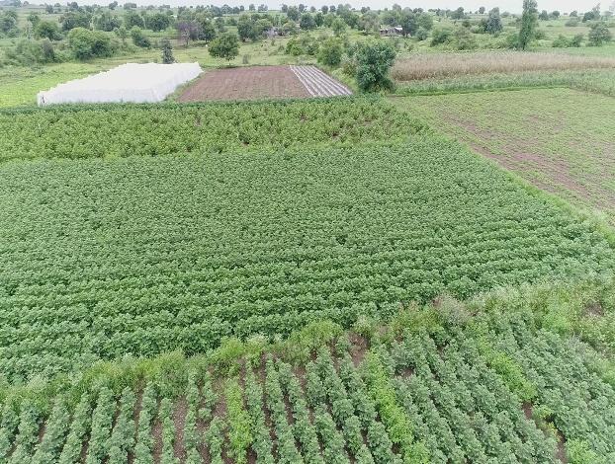
Indian farm size segmentation
It is all about the small holder farmer
Class | Std Size of land for class | No. of holdings (Million) | Avg Size of Landholding (Ha) | Total Land (Million Ha)
Marginal | < 1.0 ha | 100.25 | 0.38 | 38.10
Small | 1.0 < 2.0 ha | 25.80 | 1.40 | 36.12
Semi-medium | 2.0 < 4.0 ha | 13.99 | 2.69 | 37.63
Medium | 4.0 < 10.0 ha | 5.56 | 5.72 | 31.80
Large | 10.0 and above | 8.3 | 17.07 | 141.68
Economic survey of India 2019
Notes:
As we all know, 82% of our famers are small and marginal farmers. Small holder farmer will continue to drive future of ag so whatever we do has to be for them. And Agricultural transformation that happened in green revolution was with them , Bt cotton also with small holder farmers and so will the next transformation.

Slide 5





Ag practices of decades have resulted in significant environmental footprints
WATER &
AIR POLLUTION
SOIL DEGRADATION
DEFORESTATION
76%
So far due to agriculture
GROUND WATER DEPLETION
54%
of India’s wells with
declining levels every year
METHANE EMISSION
due to erosion
and salinity
due to livestock
farming
due to chemicals
Opportunities for Innovation
Notes:
Soil degradation, water availability, deforestation all call for new innovation and simple things like microbial health of soil can impact this. Innovation in all forms –Biological, digital, Genetics, Agronomy, etc will have to address these challenges of environmental sustainability

Slide 6

Past transformative Innovations

Slide 7
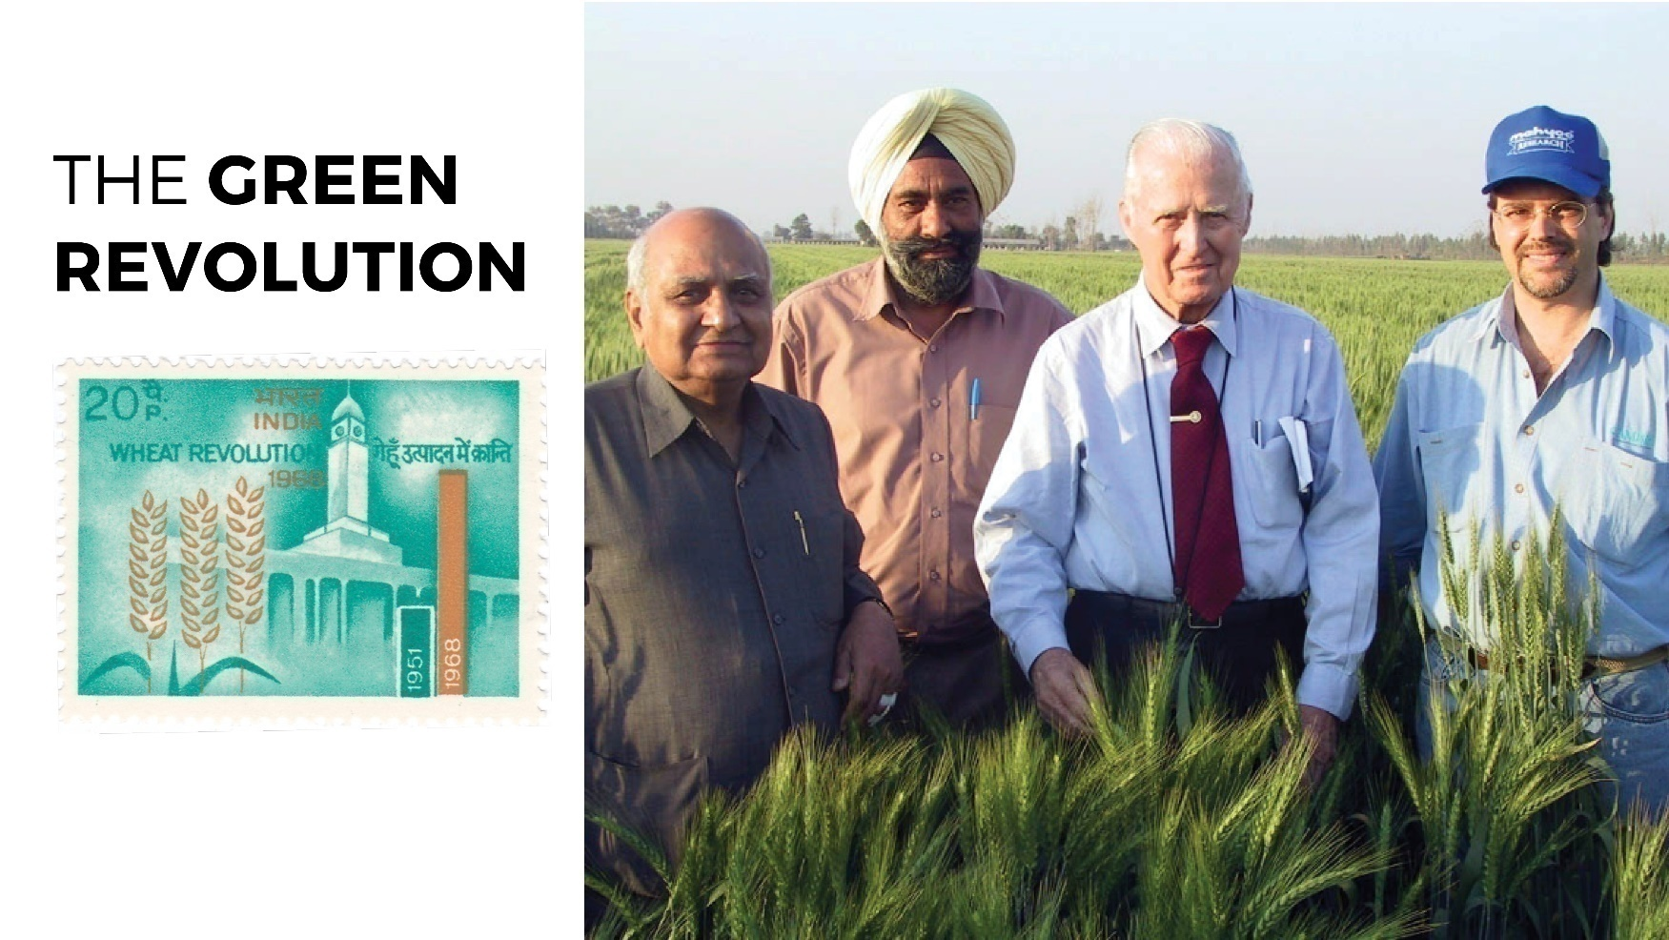
Notes:
Dr Borlaug visited us in March 2005. This picture was taken from a hybrid Wheat field in Haryana.
Wheat revolution and similar results were seen with rice. Three key contributors to Green revolution were-
High yielding varieties
Responsive to fertilizer, pesticide and irrigation
Disease resistance

Slide 8
Transformative Technologies
Wheat – High Yielding Varieties
Norin 10 with genes for stiff & short straw
Area &
Production
Yield
Introduction of HYV
Self sufficiency,
24.5 mil farmers benefitted
Real prices by 50% Affordable to consumers
1.76X Area
2.47X Yield
4.7X Production
Rs 949,025 Cr
Land savings ~ 21 Mil Ha

Slide 9
High Yielding Varieties Rice
Semi dwarfing Gene ( Dee-Geo-woo-gen)
Introduction of HYV
~35 mil farmers
benefitted
Real prices 67% Leading Exporter
33 Mn Ha saved
1.17X Area
1.8X Yield
2.08 X Prodn
Rs 580,800 Cr

Slide 10
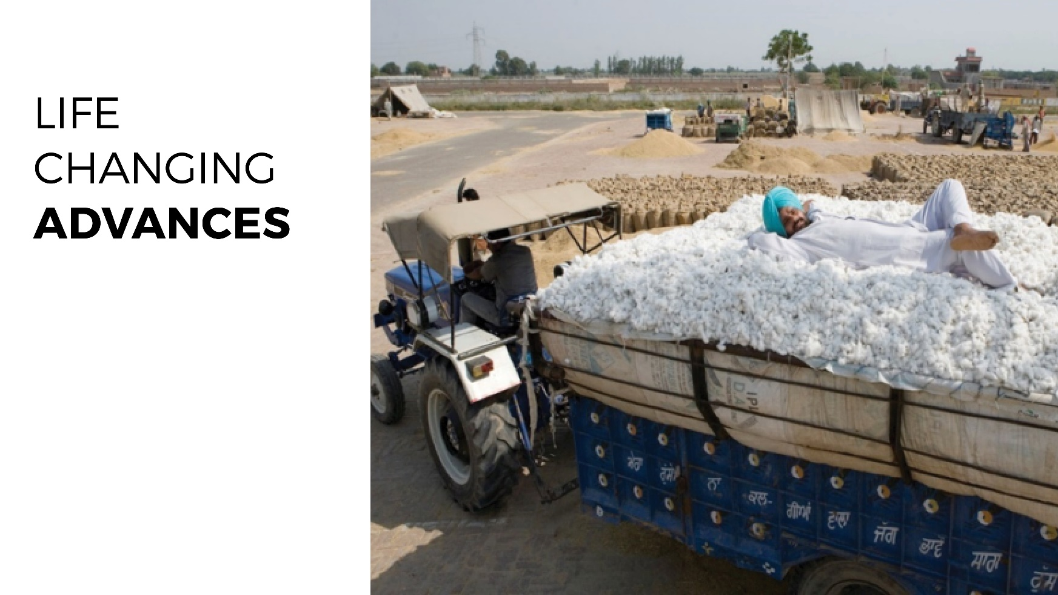
Notes:
Cotton as a more recent example

Slide 11
Bollgard Cotton
Additional income USD 18 Bn
Bollgard II® introduced
Bollgard® Introduced
Insecticides use ~ 95 %
~ 7 Million Farmers Benefitted
3x Yield
1.5x Acreage
4x Production
3x Income
Notes:
Bt Cotton is another great success story in India.
Cotton yield went up by 3 times, acreages went up by 1.5 times, and the production by 4 times.
The Fortune of the Cotton sector changed with this technology. All the stakeholders of the Cotton value chain benefitted from this technology, the largest beneficiary being rightly the farmers.
We became the second largest exporter of cotton globally from being a net importer of cotton prior to introduction of Bt Cotton.
There are several socioeconomic benefits to farming community due to bt cotton, well recorded by independent researchers.

Slide 12

Some Future Transformative Innovations in Agriculture

Slide 13
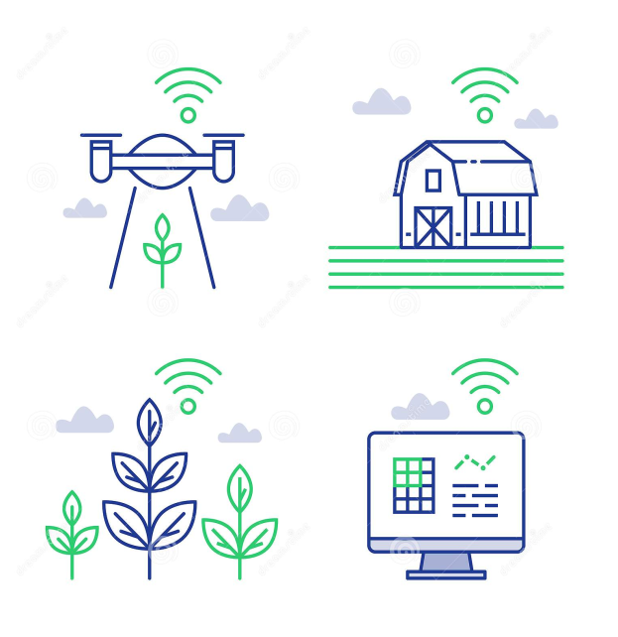
Transformative Innovations in Agriculture
Biological Nitrogen Fixation ( BNF)
Ligno-Cellulosic biomass conversion
Herbicide Tolerant crops
True Potato hybrids
High Density Planting
Imaging/phenotyping
IoT (internet of things)
Notes:
Some of the game changing transformative technologies in the medium term future will be UHDP, True Potato Hybrids, Biologicals, Digital imaging / phenotyping, AI / Machine learning, Robotics, Ligno Cellulosic biomass conversion. I will talk about a couple of these in terms of impact.

Slide 14
Biological Nitrogen Fixation
Nitrogen
  Most important plant nutrient
  Abundantly available in atmosphere
  Urea is the primary source of nitrogen; significant portion is imported
Annual consumption is ~30 million metric tons
  Total value : Rs 65000 Crs
  Subsidy provided Rs 49000 Crs
POC available
  50% replacement possible through microbial applications
Impacting environment, Enhancing farmers‘ income, import substitution

Slide 15
Conversion of ligno cellulosic biomass
516 Mn Tons of crop residue annually
Uses are
  animal feed, soil mulch, bio manure, fuel, etc.
  A significant part is burnt
274 Mn metric tons per annum is ligno cellulosic biomass
Technology now available for breakdown of biomass into lignin, hemicellulose and cellulose
Farm gate price is ~13-54 K Crores
Impacting environment, value creation, farmers income

Slide 16
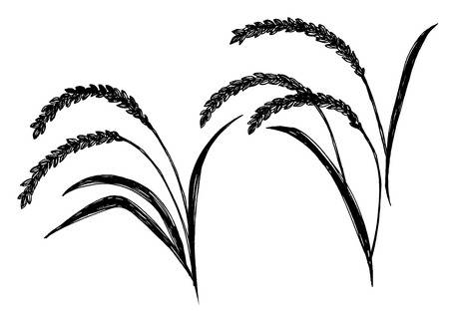
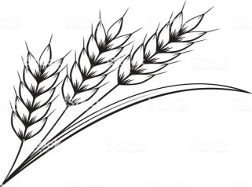
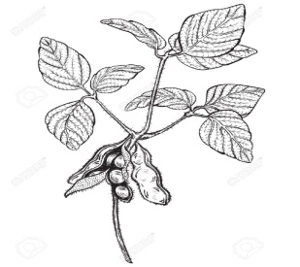
Herbicide Tolerant Crops
Herbicide Tolerant Rice
~ 44 Mn Ha
~ 35 Mn farmers
200 trillion Ltrs saving
Ground water recharged
( Source: PAU, Ludhiana study, CARJ, 2017)
Herbicide Tolerant Wheat
~29 Mn Ha
~10 Mn farmers
Ease of cultivation
(Source: ir.arcadiabio.com
Herbicide Tolerant Soybean
~10 Mn Ha
~4.5 Mn Farmers
Import substitution
Source: ISAAA.ORG
+ Environmental Foot Print, Productivity Increase, Reduced Water & Air
Pollution, + Farmers’ Income by ~20000 Crs and impact ~50 Million Farmers
)

Slide 17
True Potato Hybrids
Large staple crop propagated by tubers
Production &
Yield
Adoption
Hybrid = Disease resistance + Yield
25 gms F-1 seeds = 2.5 Mt of tuber
> 2000 Cr savings in logistics costs
Export market opportunity
1.9 X yield
2.3 X Prodn.
60% Pesticides
~ Value Rs 142500 Cr

Slide 18
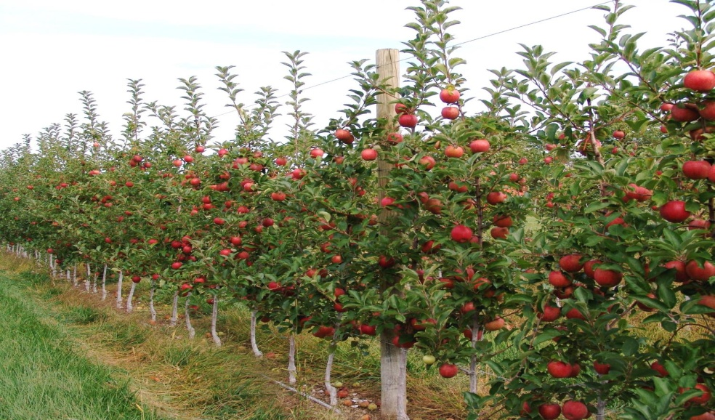
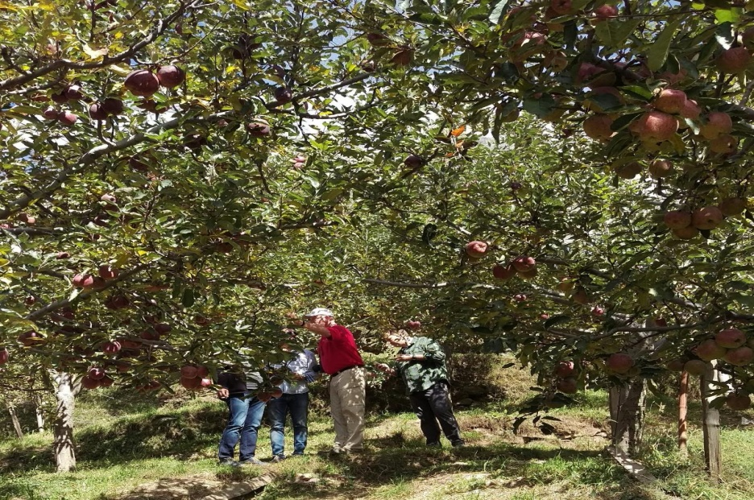
New apple rootstocks –a game changer
High Density apple orchards in USA with productivity 39.6 Tonnes / Ha
Typical Orchard in HP, India; Average India Yield 7.4 Tonnes / Ha at maturity (Picture Prof. Win Cowgill)

Slide 19
High Density planting of Fruits
Dwarfing root stock; Pruning of orchards; regulating growth
Yield
More Plants; Efficient utilization of sunlight;
Higher yield
Additional Income of ~ Rs 12000 Cr
~2 lac farmers
2X Yield
2X Production
Import substitution
Rs 14000 Crs

Slide 20
Evolution of Seed / Plant propagules Technologies
Selection of more Productive Seeds / Plants
Hybridisation technology
Grafting technologies
Use of rDNA technology
Genome editing Technologies
Plant Tissue Culture techniques

Slide 21
Factors influencing crop Productivity
Genetics of planting material
Efficient Planting technologies
Crop Management which includes crop nutrition, crop protection, water, Environment, etc
Post harvesting technologies
Above factors are a function of science based technologies and proven management practices

Slide 22
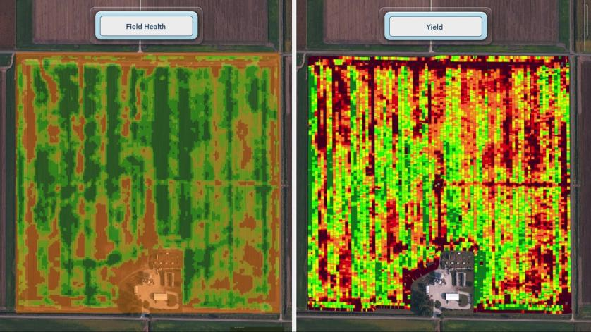
Digital technologies have potential to transform productivity
IoT based applications, Satellite technologies
Technology services related to weather forecast, risk management and crop insurance
Precision and Data driven decisions Data science moves much faster than other types of ag science. It might take 10 years to get a new biotech seed to market, but a new digital tech product might take just two years.
Notes:
How performance culture has changed
Structural response to changing market place
Culture: Innovation, rewards, short and long term incentive plan – ensure right people
Capability: Acquisition, identification of potential, investment in right people

Slide 23
Encouraging Transformative Technologies in Agriculture – An Enabling Policy Environment
Protection of IP Rights
Transformative Technologies being resource and time intensive with high risk, critical to provide adequate protection for IP rights
Enabling Regulatory system
Science based and predictable regulatory environment will help to inspire confidence
Market based pricing approach
Market based pricing helps to ensure fair competition unlike Administered pricing which would distort the market
Unified approach
Investment in education of general public through adequate communication needed for inspiring confidence
Need for alignment of approaches between Center and States, and between policy makers with different ideologies
Communication
Notes:
To elaborate further on the enabling policy environment needed to attract investments in transformative technologies, we need to create confidence that there would be adequate legal safeguards for the Intellectual property created out of such deep R&D. No one would like to see their hard and long effort being nullified by a fly by night operator stealing the technology for introducing to market at an infeasible price.
Secondly, regulatory system should be science based, predictable and transparent. It cannot be subject to vicissitude of whims making it unpredictable.
Thirdly, we must have market based pricing mechanism. Administered pricing system like in Bt Cotton creates market distortions, clearly discouraging investors. On the other hand, system must encourage fair competition in such technologies.
Given our federal political system in India, it is important to have unified approach to such nationally important matters of agricultural technologies. States and the Central governments being on different pages, major policy makers voicing contradicting view points - would not encourage investors.
Lastly, India has seen much of negative campaigns against Science & technologies during last ten years. More often these are motivated campaigns, aiming to scuttle / delay availability of cutting edge technologies to our farmers. Such communications have dented the confidence of general public in science based agriculture. It is important for the Government to strongly dispel such a negative communication and support useful technologies openly.

Slide 24
Thank you
Questions ?

Slide 25

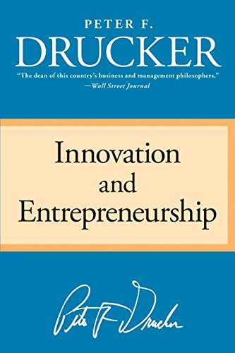


Slide 26

Concept of Entrepreneurship and Innovation

Slide 27
Entrepreneurship
Entrepreneurship
  Process of searching for change and exploiting it as an opportunity
  Can be applied across all walks of life and practiced by all
  Does not require inspiration, good luck, intuition nor one has to be a genius; it can be learned
  Requires knowledge and application of Purposeful innovation
People/ Organisations who practice Entrepreneurship survive & prosper in difficult times

Slide 28
Systematic & Purposeful Innovation
It is a tool of Entrepreneurship
Endows resources new capacity to create wealth
Purposeful search for changes; systematic analysis of the opportunities such changes might offer for innovation
Endows resources new capacity to create wealth
Neither requires geniuses nor inspiration; it is hard work
Can be applied by monitoring seven sources for innovative opportunities

Slide 29

Seven sources for Innovative Opportunities
The Unexpected
The Incongruity
Innovation based on process need
Change in Industry Structure
Demographics
Change in perception, mood and meaning
New Knowledge both scientific and non scientific

